Slide 1
NBAC TSC Slides 25 July 2024 Meeting

Slide 2
25 July 2024 NBAC TSC Agenda
1:00 NBAC Co-Chair Opening Remarks – Mr. Kamran Atri & Thomas Krul
Still awaiting GTRI contract before work will commence on completing the PS02 update to Model Version 6.0
Dr. Renner is working on the companion NDR6 update for Model Version 6.0
Encourage at minimum, 1 attendee from each Domain Space Sub-committee attend The NIEMOpen Reveal. Register before 15 November to take advantage of early bird fee
https://sites.google.com/oasis-open.org/niemopen-training-2025/register
1:05 NIEM Management Office (NMO) Update – Ms. Katherine Escobar
NIEMOpen Reveal
Link to Website : https://niemopen.org/reveal
Ways Your Company Can Participate:
Reserve seats for your key staff to attend the conference.
Organize a team to participate in the hackathon, contact: Jane Harnad.
Sponsor the event early to secure one of the limited number of sponsor tables, contact: Jane Harnad.
1:15 NTAC Update
NDR draft: “ndr6-outline.md” at https://github.com/niemopen/niem-naming-design-rules/blob/dev/ndr-v6.0-psd01.md
1:25 Communications & Outreach NMO Sub-Committee update – Paul Wormeli
1:35 Community Updates - all
1:40 Questions/Final Remarks

Slide 3


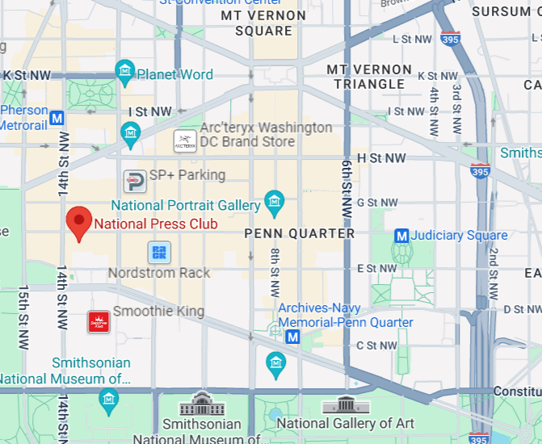

NIEMOpen reveal summit : 18-20 Feb 2025
Event Website: https://niemopen.org/reveal
Direct Registration Link: https://www.eventbrite.com/e/niemopen-reveal-training-summit-2025-tickets-890279729637
Homepage | National Press Club
Located in: National Press Building
Address: 529 14th St NW, Washington, DC 20045
Founded: March 29, 1908
Phone: (202) 662-7500

Slide 4








resources
Follow Us On Twitter
https://twitter.com/NIEMconnects?ref_src=twsrc%5Etfw
Katherine Escobar, katherine.b.escobar.civ@mail.mil, 7575-203-8631
Beth Smalley, beth.l.smalley.civ@mail.mil, 757-203-7177
Stephen Sullivan, stephen.m.sullivan14.ctr@mail.mil , 757-203-8619
https://www.niem.gov/
https://niemopen.org/
https://www.linkedin.com/groups/1903175/profile
Git Repos
NIEMOpen: https://github.com/niemopen/
NTAC TSC
https://github.com/niemopen/ntac-admin
NBAC TSC
https://github.com/niemopen/nbac-admin
NMO TSC
https://github.com/niemopen/nmo-admin
https://github.com/niemopen/nmo-training
NIEMOpen Slack Channel: https://niemopen.slack.com/
Mailing Lists
NIEMOpen: https://lists.oasis-open-projects.org/g/niemopen
PGB: https://lists.oasis-open-projects.org/g/niemopen-pgb
NTAC TSC: https://lists.oasis-open-projects.org/g/niemopen-ntactsc
NBAC TSC: https://lists.oasis-open-projects.org/g/niemopen-nbactsc
NMO TSC: https://lists.oasis-open-projects.org/g/niemopen-nmotsc
https://www.youtube.com/channel/UCg9qV22PXLBjG41hc-EwVrQ
MEP Registry & Repository
MEP Tool: https://mep.niemopen.org
CMFTool: https://github.com/niemopen/cmftool
NDR draft: “ndr6-outline.md” at https://github.com/niemopen/niem-naming-design-rules/blob/dev/ndr-v6.0-psd01.md

